Slide 1
Get Target MAC

Slide 2

Broadcast
(FF:FF:FF:FF:FF:FF)
Attacker MAC
ARP
(0x806)

Slide 3
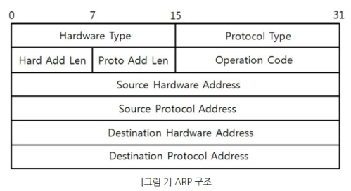
Hardware Type: 0x01
Protocol Type: 0x0800
Hard Add Len: 0x06
Proto Add Len: 0x04
Operation Code: 0x01 (ARP Request)

Slide 4
Source Hardware Address: Attacker MAC
Source Protocol Address: Attacker IP
Destination Hardware Address: Brodcast
Destination Protocol Address: Target IP

Slide 5
ARP Spoofing

Slide 6
Victim
MAC
Attacker MAC
ARP
(0x806)

Slide 7
Hardware Type: 0x01
Protocol Type: 0x0800
Hard Add Len: 0x06
Proto Add Len: 0x04
Operation Code: 0x02 (ARP Reply)

Slide 8
Source Hardware Address: Attacker MAC
Source Protocol Address: Gateway IP
Destination Hardware Address: Victim MAC
Destination Protocol Address: Victim IP

Slide 9
ARP Recovery

Slide 10
Victim
MAC
Gateway
MAC
ARP
(0x806)

Slide 11
Hardware Type: 0x01
Protocol Type: 0x0800
Hard Add Len: 0x06
Proto Add Len: 0x04
Operation Code: 0x02 (ARP Reply)

Slide 12
Source Hardware Address: Gateway MAC
Source Protocol Address: Gateway IP
Destination Hardware Address: Victim MAC
Destination Protocol Address: Victim IP

